Slide 1
Recitation 5

Slide 2
Info
Jon Rutkauskas
Recitation: Tue 12-12:50
Office Hours: Tue 11-11:50 Thur 11-12:50 SENSQ 5806 (additional hours by appointment if needed)
On discord: @jrutkauskas
By email: jsr68@pitt.edu
Github: https://github.com/jrutkauskas/spring2019-449-rec
Ask me any questions you have!!!

Slide 3
Warmup Polls

Slide 4
Debugging and GDB
Isn’t it annoying when your program doesn’t do what you want it to do?
We have to debug it to figure out what’s going wrong.
Currently, you’ve probably been doing a lot of debugging with print statements
E.g., printf(“Made it to function B!, x is %d”, x)
We can do better!

Slide 5
Debugging and GDB
A debugger is a tool we can use to “watch your program fail in slow motion” (Jarrett’s words)
We can see where it’s breaking, how it’s breaking, and other information about our program as it breaks
You may have used an IDE’s built-in debugger before, such as in Visual Studio or Eclipse
Have you set breakpoints, stepped through lines of code, viewed local variables live, or viewed the current stack? -- If so, you’ve used a debugger!
We’ll use gdb in this class for debugging

Slide 6
Super Simple Program
#include <stdio.h>
#include <stdlib.h>
int add(int* x, int* y);
int main()
{
int *x = malloc(sizeof(int));
*x = 4;
int* y = *x + 10;
int sum = add(x,y);
printf("Sum is: %d", sum);
return 0;
}
int add(int* x, int* y)
{
return *x + *y;
}

Slide 7
When we Run it…
Use –g flag to help debug later
[thoth ~/private/449/lab4]: gcc -g -o simple simple.c
simple.c: In function ‘main’:
simple.c:11: warning: initialization makes pointer from integer without a cast
[thoth ~/private/449/lab4]: ./simple
Segmentation fault (core dumped)

Slide 8
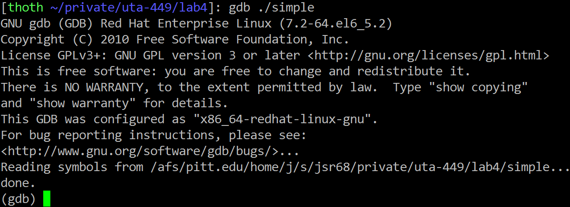
Let’s use GDB!
[thoth ~/private/449/lab4]: gdb ./simple

Slide 9
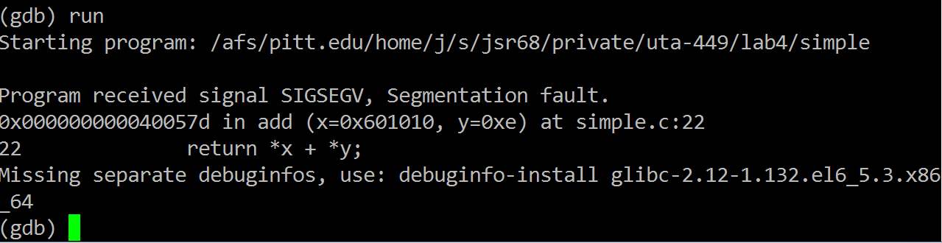
Type ‘run’ to run

Slide 10
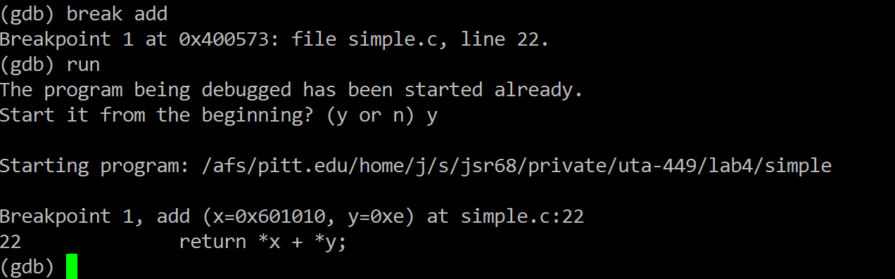
Let’s add a breakpoint!

Slide 11
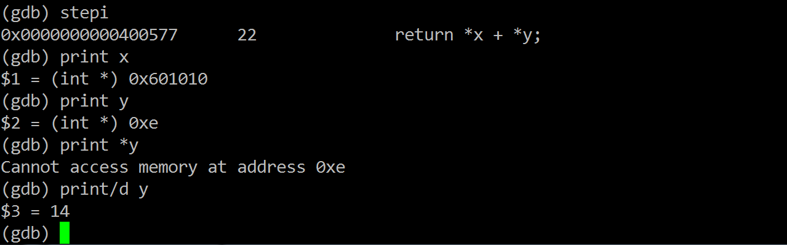
Use ‘stepi’ to step to the next instruction.
GDB prints the line number and code

Slide 12
Let’s see what x is

Slide 13
…it’s some memory address, which we expect to point to the integer we want to sum with *y

Slide 14
Okay, so what’s y

Slide 15
…hmm that seems like a pretty odd memory address?

Slide 16
Let’s see what it points to…

Slide 17
Yikes! There’s our segfault. We can’t dereference that!

Slide 18
Printing that out as a decimal tells us it’s 14.

Slide 19
Let’s look back at our code
#include <stdio.h>
#include <stdlib.h>
int add(int* x, int* y);
int main()
{
int *x = malloc(sizeof(int));
*x = 4;
int* y = *x + 10;
int sum = add(x,y);
printf("Sum is: %d", sum);
return 0;
}
int add(int* x, int* y)
{
return *x + *y;
}
Looks like we should have done this differently

Slide 20
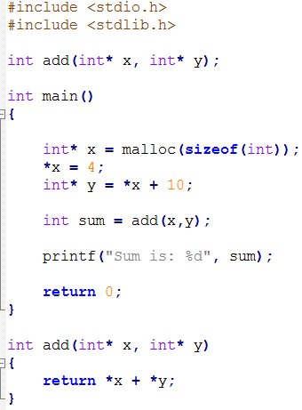
How Can We Fix This Code?

Slide 21
How Can We Fix This Code?
int y = *x + 10;
int sum = add(x,&y);

Slide 22
Quitting
After we’re done, to quit, just type ‘quit’ into gdb and answer ‘y’ that we want to end the currently running process

Slide 23
Lab 4
Lab 4 gives you a much bigger look into gdb.
It can do a ton more!
You’ll need this a lot for your projects, both current, and future :-)
Try to get a lot of practice with this, especially setting breakpoints, stepping though instructions (step, next, stepi, nexti), using ‘where’ for a stack trace, and printing out variables (or any other C expression)

Slide 24
Other Questions

Slide 25
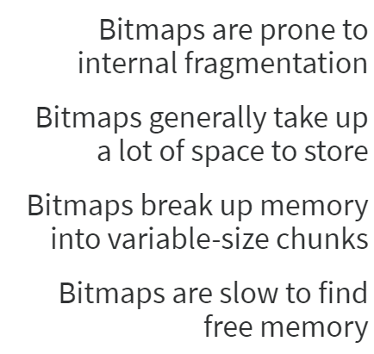
Which of these is not true of bitmaps (Memory Allocation)

Slide 26
Which of these is not true of bitmaps (Memory Allocation)
Bitmaps, by breaking up memory into FIXED size chunks; the allocator will always use AT LEAST as much memory as the user requires. So, if the memory is broken up into 32 byte chunks (for example) and a user wants 60 bytes of memory, we would allocate 2 32 byte chunks = 64 bytes, thereby wasting 4 bytes – Internal Fragmentation
The Linked Chain memory allocation also has internal fragmentation, but not like this
Bitmaps CAN take up a lot of space, 1 bit per chunk. If we have a bunch of tiny allocations, bitmaps might be better space-wise, but 32 byte chunks when we need to allocate, say, a 3MB WAV file…
3MB/32 Bytes = 93750 bits in bitmap = over 11k! Versus a Linked chain with 1 single header (2 pointers and 2 ints)
Bitmaps must use fixed-size chunks, otherwise we wouldn’t know how large a single chunk is since we denote a chunk with a single bit (not some int or something)
Bitmaps ARE slow. Lots of shifting and searching down the bitmap, lots of bitwise operations. Computers aren’t really built to be fast for all that.

Slide 27
First Fit
Note: X is most recently allocated block
A
B
C
X
D
E
?
Where would this memory go if we tried to allocate it using first fit?
We need 54 Bytes.
A is 60 Bytes
B is 58 Bytes
C is 28 Bytes
D is 80 Bytes
E is 128 Bytes

Slide 28
First Fit
Note: X is most recently allocated block
A
B
C
X
D
E
?
Where would this memory go if we tried to allocate it using first fit?
We need 54 Bytes.
A is 60 Bytes
B is 58 Bytes
C is 28 Bytes
D is 80 Bytes
E is 128 Bytes

Slide 29
Next Fit
Note: X is most recently allocated block
A
B
C
X
D
E
?
Where would this memory go if we tried to allocate it using Next-fit?
We need 54 Bytes.
A is 60 Bytes
B is 58 Bytes
C is 28 Bytes
D is 80 Bytes
E is 128 Bytes

Slide 30
Next Fit
Note: X is most recently allocated block
B
C
?
E
A
X
D
Where would this memory go if we tried to allocate it using Next-fit?
We need 54 Bytes.
A is 60 Bytes
B is 58 Bytes
C is 28 Bytes
D is 80 Bytes
E is 128 Bytes

Slide 31
Best Fit
Note: X is most recently allocated block
A
B
C
X
D
E
?
Where would this memory go if we tried to allocate it using Best-fit?
We need 54 Bytes.
A is 60 Bytes
B is 58 Bytes
C is 28 Bytes
D is 80 Bytes
E is 128 Bytes

Slide 32
Best Fit
Note: X is most recently allocated block
A
B
C
X
D
E
?
Where would this memory go if we tried to allocate it using Best-fit?
We need 54 Bytes.
A is 60 Bytes
B is 58 Bytes
C is 28 Bytes
D is 80 Bytes
E is 128 Bytes

Slide 33
Worst Fit
Note: X is most recently allocated block
A
B
C
X
D
E
?
Where would this memory go if we tried to allocate it using Worst-fit?
We need 54 Bytes.
A is 60 Bytes
B is 58 Bytes
C is 28 Bytes
D is 80 Bytes
E is 128 Bytes

Slide 34
Worst Fit
Note: X is most recently allocated block
A
B
C
X
D
E
?
Where would this memory go if we tried to allocate it using Worst-fit?
We need 54 Bytes.
A is 60 Bytes
B is 58 Bytes
C is 28 Bytes
D is 80 Bytes
E is 128 Bytes

Slide 35
Project 2
Project 2 will give you some wonderful experience with how linked-chain memory allocators work.

Slide 36
Any Other Questions for the Good of the Group?

